Slide 1
Policies, Standards and Procedures (PSPs)
New Policy Rollout

Slide 2
Learning objectives
Introduce the new procedure for reviewing and approving new policies
Introduce the new webpage containing new policies
Answer your questions
Any others?

Slide 3
Summary
A.R.S. § 41-3504 and § 41-3507 require ADOA-ASET to publish IT policies, standards and procedures (PSPs)
Many State of Arizona PSPs are outdated and need to be refreshed
ADOA-ASET developed new policies and is requesting your comments

Slide 4
New Policies Available for Review
P1000 Information Technology Policy
P1050 Policies, Standards and Procedures Policy
P1250 Website Acceptance Policy
P1300 Website Accessibility Policy
P1360 Information Technology Planning Policy
P1650 Release Management Policy
P3600 Domain Naming Policy
P5000 Vendor Management Policy
P5050 Social Networking Policy
P7000 Enterprise Architecture Policy
P7100 Network Architecture Policy
P7300 Software Architecture Policy

Slide 5
New Policies Available Soon
P7400 Data Governance Organizational Policy
P7430 Data Governance Technology Policy
P7450 Data Operations Policy
P7470 Data Governance Documentation Policy

Slide 6
PSP Procedure
ADOA-ASET drafts policies in MS Word and publishes to the website for comment
Budget unit delegates review drafts and provide comments in MS Word until closed
ADOA-ASET reviews your comments, one policy at a time, modifies draft policies and updates webpage
Final drafts are published to the ADOA-ASET PSP webpage as a PDF

Slide 7
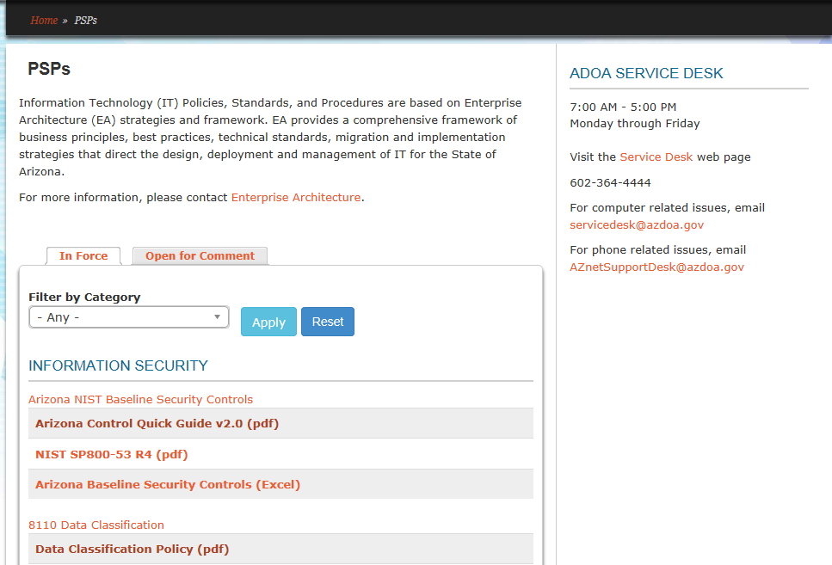
PSP Website (https://aset.az.gov/resources/psps)
In Force PSPs

Slide 8
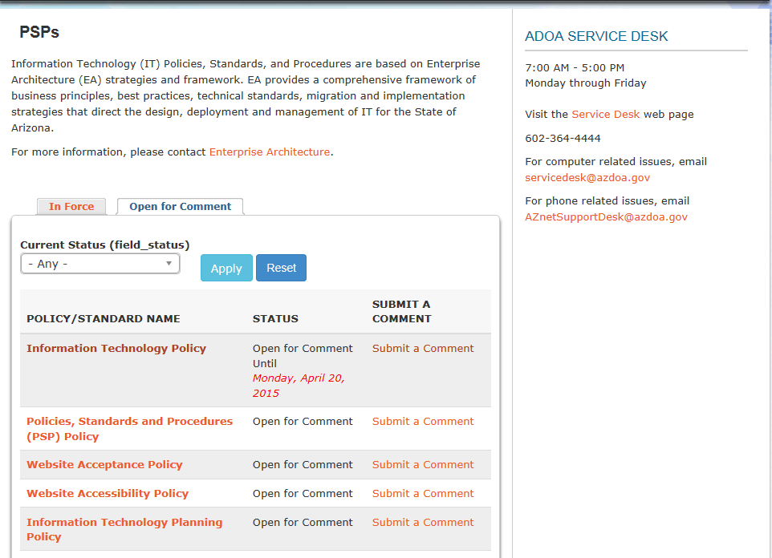
PSP Website (https://aset.az.gov/resources/psps)
Open for Comment PSPs
Click here to submit a comment
Click here to open draft policy

Slide 9
Review, Edits and Comments
You may edit the draft and submit the entire document
You may review the draft and submit comments only
You may review the draft and approve as-is

Slide 10
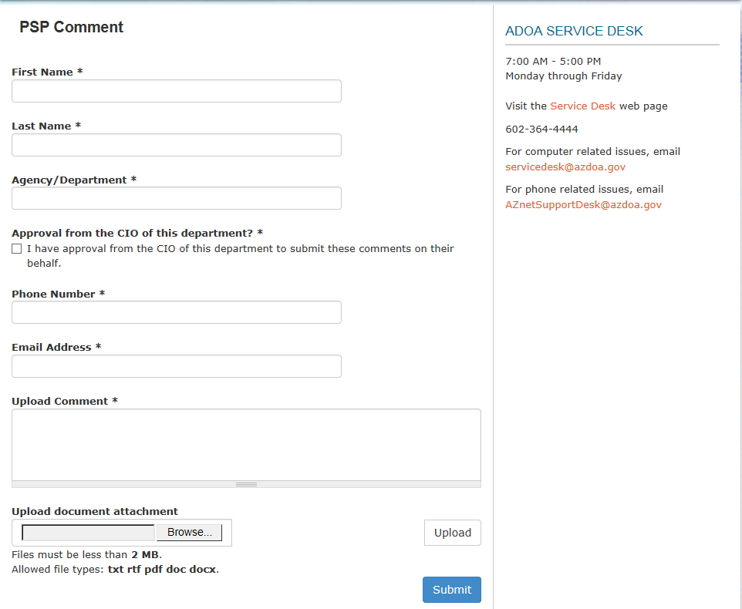
Comment Form
Contact information
Comments
Upload revised document

Slide 11
FAQs
How were new policies selected?
We reviewed all existing policies and selected the most important.
What happens to the old policies?
The old policies are still in force until replaced or sunsetted.
What is the basis for the new policies?
We used a variety of sources including CobiT, ITIL, CMMI and policies from other states.

Slide 12
FAQs
What happens if our BU needs an exception to sections of a policy?
BUs may request exceptions using the Statewide Policy Exception Procedure (included in each policy) at any time and indicate the exceptions in their BU IT policy.
Why do we need Statewide Policies?
Arizona Revised Statutes require them, they are considered a best practice for IT governance and the AG’s Office audits for them.
How long do we have to submit our comments?
The review period is around two weeks.

Slide 13
Questions?
Contact information:
Raj Kollengode
Raj.kollengode@azdoa.gov
602 364-4790
Paul Engle
Paul.engle@azdoa.gov
602 364-4959
Jeff Wolkove
Jeff.wolkove@azdoa.gov
602 542-2253

