Slide 1
Presentation to ITAC
AZ DCS CHILDS Replacement Project (Guardian Program)
State of Arizona – Department of Child Safety
July 27, 2016

Slide 2
Contents
Guardian Overview
Title IV-E Overview
Child Welfare Information System
Current Status
Financials
Q&A
Further Information

Slide 3
Guardian Overview
Solution | Guardian will be a usability centric, CCWIS compliant solution built upon a single technology platform that readily facilitates process driven DCS work activities and delivers more contemporary collaboration with all DCS partners.
Procurement Strategy | A mobile first strategy will generate efficiencies by adding capability to a field worker’s existing toolbox. Concurrently selecting and implementing a technology platform will enable a more consistent data model upon which all process driven functionality modules will be built.
Cost and Funding | ACF approved 50% match development and maintenance costs
Timeline | Capabilities and benefits of Guardian will become available starting with the Mobile solution functionality as early as Q4 FY17. Incremental implementations continue until Q2 FY20.

Slide 4
Title IV-E Overview
Social Security Act provides Federal Funds for Child Welfare programs:
Title IV-E Foster Care
Title IV-E Guardianship Assistance
Title IV-E Adoption Assistance
Funding up to 50% match is dependent on Federal review and approval
DCS child welfare programs are approved for full 50% match
Federal match funding is also available for child welfare IT systems
Funding up to 50% match is dependent on Federal review and approval
The initial Federal guidelines were known as SACWIS (State Automated Child Welfare Information System)
From 8/1/2016 SACWIS will be replaced by CCWIS (Comprehensive Child Welfare Information System)

Slide 5
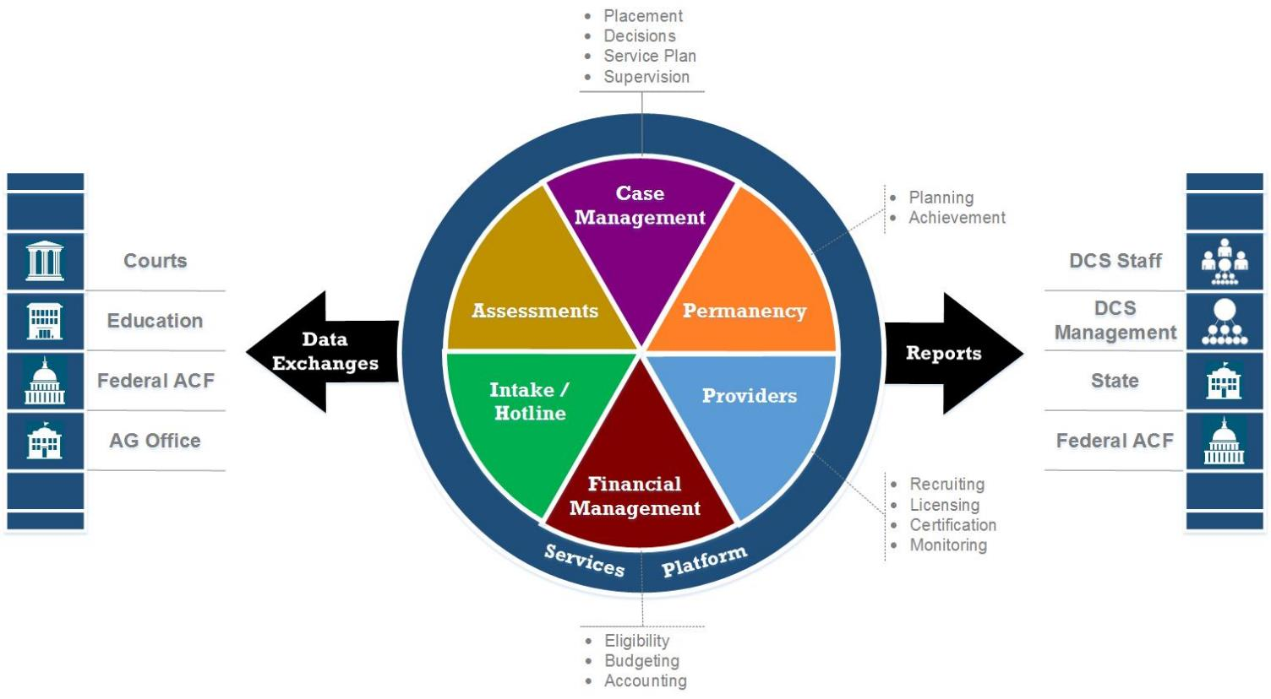
Child Welfare Information System

Slide 6
Guardian Status
Done
Now
Next
Completed Feasibility Study
Requirements for RFPs
Alternatives Analysis
Solution Recommendation
Cost Benefit Analysis
Completed IAPD
Federal Match Funding Approved
Mobile Solution RFP Issued
Platform RFP Issued
Refine Roadmap and Finalize Baseline Budget Forecast
Evaluate Eight Mobile Solution Bids
Finalize Data Management Assessment Solicitations
Mobile Solution Award
Platform RFP Bids Evaluation
Upcoming RFPs Planned:
IV&V Solution(s)
Quality Management
Technical Integration

Slide 7
Financials
$300,000
$1,250,000
$3,750,000
$1,475,000
$2,750,00
Projected JLBC Asks through FY17
$1,400,000
Spend to Date

Slide 8
Q&A

Slide 9
Further Information
Guardian Timeline
Guardian Capability and Benefits Timeline
Risks

Slide 10
Guardian Timeline
Issue Mobile Solution RFP
Issue IV&V RFP
Issue Quality Management RFP
Issue Platform RFP

Slide 11
Guardian Capabilities and Benefits Timeline
Data Deduplication
Full Data Integrity
Mobile Solution
Data Model
Priority Exchanges
Additional Exchanges
All Exchanges
Priority Reports
All Reports
Initial Intake / Hotline
e.g. CSRA
All Intake / Hotline
Provider Licensing
Initial Case Manage
e.g. TDM, Document Mg
Priority Case Manage
All Case Management
Initial Assessments
Assessments
All Financial Management
Provider Financial Mg

Slide 12
Risks
risk | response
Executive Sponsorship Impact on agency organization, budget, effort | Reorganized Steering Committee to enable quicker decision making Specialized working groups to advise
Project Complexity Incremental benefit delivery requires coordination Data management between CHILDS and Guardian | IV&V vendor to maintain oversight and quality monitoring during the full span of the project Schedules with dependencies and contingency Coordination of CHILDS decommissioning
System Complexity Integration and configuration complexity | Industry standards, using a Platform foundation DCS oversight of vendors
Funding DCS and Federal budgets | Agreed funding to complete solution Buy-in from State, Federal, and DCS management
Competitive Procurement Limited vendor and evolving product market | Procurement strategy coordinated with RFP and evaluation criteria
System Acceptance Management need for reporting and analytics Changing DCS processes while configuring system Busy caseworkers with limited time for training | Business process redesign informs configuration Incremental delivery provides early successes, champions, and growing understanding Communication and training provides awareness

