Slide 1
Corporations
Software Replacement
Letty Butner, CIO
Arizona Corporation Commission
August 10, 2016

Slide 2
Purpose
To present data requested from July ITAC presentation regarding the Arizona Corporation Commission plan to purchase a Customizable Off-the-Shelf (COTS) solution to replace antiquated software used for Corporation and LLC name reservation, registration, maintenance, and dissolution.
Obtain ratification

Slide 3
Agenda
Recap
Amazon vs. Azure cloud hosting cost
PCC Technology Group financial health

Slide 4
Recap
Stated the need to replace our STARPAS software used for Corporations and LCC life-cycle management.
Presented plan for the purchase of COTS software called Cenuity from PCC Technology Group, as well as professional services, through state contract.
The software has been implemented for corporation filings in 7 states: Indiana, Georgia, Connecticut, Vermont, New Mexico, Louisiana, and Washington.
Shared worst-case 5 year costs of 2.23M, and we have 2M funding allocated, rest will be covered by the ACC.

Slide 5
Cloud Cost
Presented worst case scenario of cloud costs with AZURE hosting (presented a stand-alone cost).
We are currently an AZURE government cloud tenant and have been since March 2015 per our enterprise agreement purchased through state contract.
A comparison of Amazon to Azure for the worst case scenario, reviewed by DOA is:
Amazon Gov 42.1k/yr
AZURE Gov 33.6k/yr
The difference above is SQL cost.

Slide 6
Cloud Cost
SQL and window licensing on-site shows lesser costs:
Scenario 1: Stand-alone compare:
Amazon Gov 18.5k/yr
AZURE Gov 15.4k/yr
Scenario 2: All ACC needs with the PCC software included
Amazon Gov 35.7k/yr
AZURE Gov 26.3k/yr
The ACC has already been budget forecasting cloud services for FY2017 and beyond at ~27k per year, which included the expected STARPAS replacement cost.
The PCC requirements are in line with our expectations on cost.

Slide 7
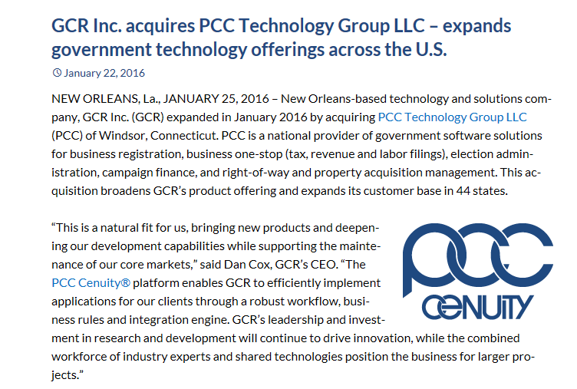
Financial Health
PCC Technology Group was purchased by GCR Inc. in January 2016.
Per their media announcement, this expands their reach to 44 states total and they want to expand use of the Cenuity product platform.

Slide 8
Financial Health
SPO contacted PCC Technology Group, reviewed financials for GCR Inc., and performed a financial analysis resulting in an assessment result of: “financially sound for a private company”.
According to SPO State Procurement Manager Reem Prendiville, “SPO has no concerns regarding the solvency of GCR, and we can require a parent company guarantee from PCC”.

