Slide 1
AZNet II VOICE & NETWORK OVERSIGHT COMMITTEE
April 12, 2018

Slide 2
AZNet II Voice & Network Oversight Agenda
Call to order
Roll call
Presentations
AZNet II Operations
SIP Transition
WebEx Storage
Carrier Hosts
AZNet III Timeframe
Hosted Mainframe Services Operations
Shared Hosted Data Center
Contractual Updates
IBM Hosted Mainframe
Adobe
Round Table and Adjournment

Slide 3
ESS Organization
Suzan Tasvibi
Chief of Enterprise Shared Services
Pam Dreyer
Director of Network Operations EIC
Annabelle Molina Portfolio Manager Managed Services
Marcy Fleming Customer Portfolio Manager
Barbara Jaeger
State 911 Administrator
Patrick Cravens Hosted Mainframe Services Manager
Allan Gazza
IT Infrastructure Manager

Slide 4
AZNet II Operations

Slide 5
Session Initiation Protocol (SIP)
The Session Initiation Protocol (SIP) is a communications protocol for signaling and controlling multimedia communication sessions in applications of Internet telephony for voice and video calls, in private IP telephone systems, as well as in instant messaging over Internet Protocol (IP) networks.
The States desire is to deploy a SIP solution for the State to convert legacy PSTN connections to SIP trunking to align with the central voice services solution, reduce shared infrastructure costs, and to increase efficiencies and functionality to the State while providing geographical diversity and which is robust enough to handle the State’s calling needs on a large scale. SIP trunking reduces the inefficiencies of time division multiplexing (TDM) technology by enabling the pool of voice network capacity for dynamic utilization and improving usage visibility for greater cost control and capacity management. SIP trunk business continuity and redundancy options provide opportunities that can avert a single point of failure within the voice architecture.

Slide 6
Session Initiation Protocol (SIP)
Total, Current Local Costs Monthly $91,093.49 Total, Future SIP Costs Monthly $53,862.70
TOTAL Projected LOCAL COST SAVINGS Monthly: $37,230.79

Slide 7
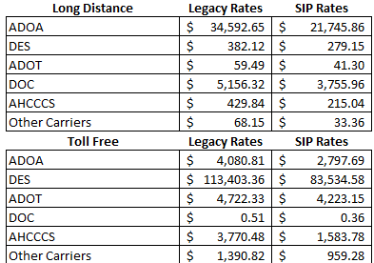
Session Initiation Protocol (SIP)
Long Distance / Toll Free Changes Estimated:
Long distance and Toll Free are usage base so, we are not able to show a firm cost savings. Below is a comparison based on a one month snapshot showing the possible savings in these two categories.

Slide 8
WebEx Storage

Slide 9
WebEx Meeting Recording Storage
Current Storage Status
Current space allocation on WebEx server - 50GB * Current utilization is @ 80%
Current Active WebEx Users 2,719
Max available 25,000
WebEx users currently using storage 348
Current Storage file size range(s) 1.23 mb - 2201.85 mb
Space allocated per user- no restrictions -first in
Expansion capabilities up to 1TB @additional $1000.00 x 27 Months =$27,000.00 OTC

Slide 10
WebEx Storage Continued
Recommendations
Each Agency should follow their own retention schedules
Recordings should be downloaded for long term storage
Instructions are located on the AZNet or Cisco web page(s)
https://aset.az.gov/aznet-ii-arizona-network
https://collaborationhelp.cisco.com/article/en-us/nzpa89j

Slide 11
Carrier Hosts

Slide 12
Carrier Metro Optical Ethernet (MOE) Hosts - Current
Cox - Two hosts
Phoenix 500M bandwidth profile/10G interface
Tucson 500M bandwidth profile/1G interface
CenturyLink - Three hosts
Phoenix IO 1G bandwidth profile/10G interface
Phoenix 206 2G bandwidth profile/10G interface - No change
Tucson 1G bandwidth profile/1G interface
Level 3/CenturyLink - Two hosts
Phoenix 1G bandwidth profile/10G interface - No change
Tucson 1G bandwidth profile/1G interface - No change
Zayo (formerly known as Electric Lightwave formerly known as Integra)
Phoenix 100M bandwidth profile/1G interface
Tucson 500M bandwidth profile/10G interface

Slide 13
Carrier Metro Optical Ethernet (MOE) Hosts - New
Current bandwidth is not sufficient to support the needs of agency remotes. Orders placed to increase bandwidth profile.
Cox orders in progress to increase from 500M to 2G bandwidth profile on 10G interface (Phoenix IO & Tucson)
Total monthly increase to Shared INFRA is $699.00 (excluding taxes and fees)
CenturyLink orders in progress to increase from 1G to 2G bandwidth profile on 10G interface (Phoenix IO & Tucson)
Total monthly increase to Shared INFRA is $2,520.00 (excluding taxes and fees)
Level 3 1G bandwidth profile on 10G interface - no change. Currently working with CenturyLink Team to acquire more information on the merger and what the future entails of the existing Level 3 infrastructure.
Zayo orders in progress to increase from 500M to 1G bandwidth profile on 10G interface (Phoenix IO & Tucson).
Total monthly increase to Shared INFRA is $1,718.00 (excluding taxes and fees)

Slide 14
AZNET III RFP Timeline
LOREM
Kick Off
Kick Off
Q4
Q4
Q1
Q1
Q2
Q2
Q3
Q3
April
April
May
May
June
June
July
July
August
August
September
September
October
October
November
November
December
December
January
January
February
February
March
March
Agency Engagement / SOW
Agency Engagement / SOW
Final Draft RFP to SPO
Final Draft RFP handoff to SPO
Release RFP
Release RFP
Responses, questions, evaluations
Responses, questions, evaluations, BAFO
Responses, questions, evaluations
Award

Slide 15
Infrastructure Updates

Slide 16
Hosted Mainframe
Transition of ADOA Mainframe Workload to IBM zCloud
Transition began on July 7, 2017 after SPO initiated contract with IBM.
Successfully transitioned current ADOA Mainframe Operational environment to IBM
19 ADOA employees rebadge to IBM employees to ensure continuity of service to agencies.
Rebadged employees relocated to IBM Phoenix office
Network between ADOA and Boulder established November 2017
Mainframe Disk Storage Data Replicated December 4, 2017
First Dry run accomplished December 11th, 2017
Second Dry Run accomplished January 7th, 2018
All Mainframe agencies transitioned to production environment in Boulder on January 21st, 2018.

Slide 17
Hosted Mainframe
ADOA Mainframe Workload to IBM zCloud - Results
First full business day of processing; Monday January 22, 2018.
Realized Benefits:
Support Staffing - IBM bench strength brings in depth support
Mainframe process that were taking weeks are now running in days
(400%+ Overall performance increase due to upgraded processor and storage systems)
ADOA/ASET Operational budget stability
Business Continuity Services
Disaster Recovery site no longer in Phoenix
Robust network capability for Business Continuity
Available staffing for any recovery scenarios and long term recovery
Hardware and Software currency (N-1) thus eliminating the need for Capital Expenditures for newer processors, storage or software.

Slide 18
IO Data Center Update
Floor Space
1920 RU being built out in 4 server rows
480 RU available now, remaining being configured now
4th Server row cabinets installed
Fiber Connections
144 additional fiber ports to MMR installed on diverse paths
Direct ADOA owned fiber hand-off to DC-1 raised floor space - 24 strands on diverse paths
Direct ADOA owned fiber hand-off to DC-7 Network Modular - 96 strands on diverse paths
All fiber meets stringent Tier 1 & Tier 2 testing

Slide 19
IO Data Center Update
Data Center Specifications
Data Center specifications written to include the following specifications:
All fiber infrastructure is tested to Tier 1 & Tier 2 standards to avoid future connectivity issues.
All fiber infrastructure including patch cords are cleaned and scope tested until passing results are achieved. Cyxtera also required to perform this on any State of Arizona connections.
All fiber is required to be fusion spliced. No unicam or hand polished fiber accepted.
Standardized Parts list
GrayBar will carry inventory of common parts used by the State of Arizona at IO Data Center so there will be no lead time on receiving parts. Parts list to be available soon for all agencies of in-stock products. (Includes Panduit fiber cassettes, Quicknet panels, fiber cleaners, patch cords, and other high use items)
Let me know if there are other items your agency orders frequently.

Slide 20
Contract Updates

Slide 21
IBM Hosted Mainframe Contractual Update
●Customer Impacting
○Amendment 1:
■IBM will monitor the Control-M Enterprise Manager including AHCCCS and HRIS open system processing.
○Amendment 2:
■IBM will measure Software Currency to be at N or N-1 per the State’s directive as part of the Task Order SLR’s
●Non Customer Impacting
○Amendment 1:
■IBM will be supplied State Employees actuals from 08/31/17 payroll to assist in rebadging process
○Amendment 2:
■To align with the acceptance of IBM’s exceptions SLR Factor was adjusted to the agreed upon 150%.

Slide 22
Adobe Enterprise Contract Update

Slide 23
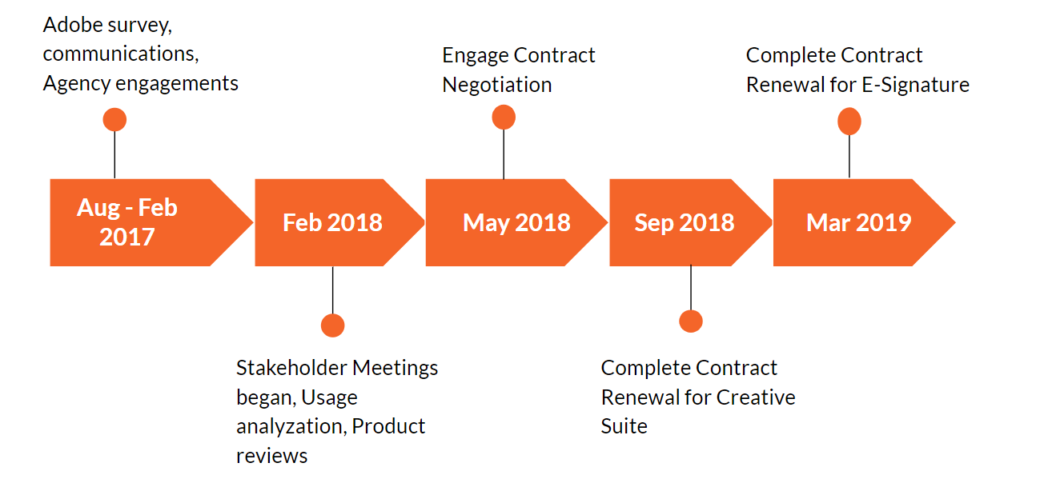
Adobe Timeline

Slide 24
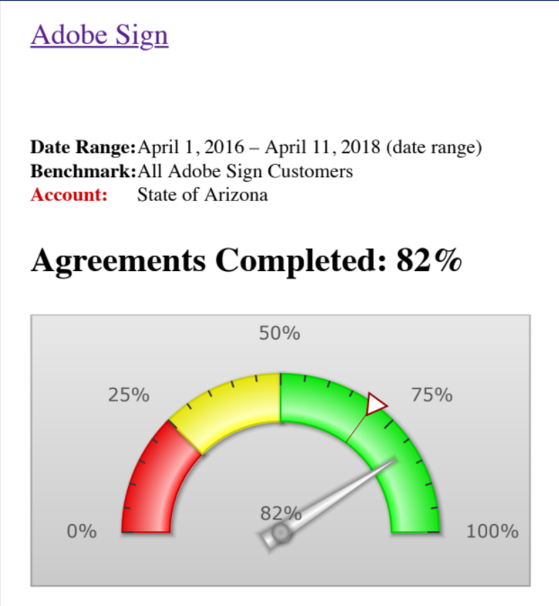
Adobe Products
All Adobe applications in the Creative Cloud Suite and Adobe Sign (e-Signature) are available statewide
Adobe Sign (4/1/16 - 4/11/18)
Total Sent: 9309
Canceled or Rejected: 622
In Process: 392
Completed: 7636
Expired: 659
Unique Senders: 119

