Slide 1
OVERSIGHT COMMITTEE
September 29, 2016

Slide 2
Agenda – 9-10am
State Business
Approval of meeting minutes – January 28, 2016
Oversight Membership 2017
Oversight Committee Charter
New TEM Contract
AZNet II Extension, Amendment 6
Break (10 minutes)

Slide 3
Oversight Membership
Voting Members
Suzan Tasvibi-Tanha, co-chair | ASET Enterprise Infrastructure & Communications | ADOA-ASET-EIC
Roger Baune, co-chair | Department of Public Safety (PS) | Medium Agency
Charles Brown | Board of Physical Therapy (PT) | 90-10 Representative
Gary Heller | Department of Environmental Quality (EV) | Medium Agency
Jennifer Dvorak | ASET Security Privacy & Risk | CISO Designee
Joseph Nicoletti | Department of Corrections (DC) | Large Agency
Mike Collins | Department of Gaming (GM) | Small Agency
Mike Upchurch | AZ Health Care Cost Containment System (HC) | Medium Agency
Owen Zorge | Department of Emergency & Military Affairs (MA) | Small Agency
Robert Fisher | ASET Enterprise Infrastructure & Communications | ADOA-ASET-EIC
Sally Grimm | Department of Economic Security (DE) | Large Agency
Sandip Dholakia | Department of Revenue (RV) | Medium Agency
Tami Price | Department of Transportation (DT) | Large Agency
Co-Chair Decision for 2017
Currently have 13 members, charter calls for 14 – Missing 1 small agency

Slide 4
Oversight Charter
Shifted Focus from Refresh to Operational
Updated Title Changes within ADOA-ASET
Confirmed Committee Responsibilities

Slide 5
New TEM Contract
RFP went out fall 2015, awarded Spring 2016
Awarded to Telesoft LLC*
Effective date September 22, 2016 – September 21, 2019
No Transition Cost
Cost Reduction - $58,283 monthly → $49,000
Upgraded Platform
Three Trainings – Dates to be Determined

Slide 6
Contract Extension

Slide 7
Effective Dates
Current Contract Expires : March 8, 2017
New Contract Expiration date: September 7, 2019
Effective date of key changes : March 1, 2017
Extension was executed for 30 months
Effective billing cycle: April bill - New pricing will be on April Billing for March Services

Slide 8
Negotiation Consideration
The initial 5 year term of the contract scheduled to expire March 2017
The contract allowed for an optional extension at the State Procurement Office’s sole discretion
If State was able to negotiate significant savings, the full 30 month extension would be offered
If the State was not able to obtain significant savings, then the extension period would cover the RFP and new contract award
AZNet II Oversight Committee

Slide 9
Negotiation Results
Overall Seat and Services Price Decrease of 31%
Consolidate Pricing Tables
Equipment Acquisitions
NEW and Expanded Sites
Existing Equipment
State Core Expansion
Continue to provide all Services currently providing, minus providing free equipment for core expansion or any new remote sites or site expansions over 20 seats

Slide 10
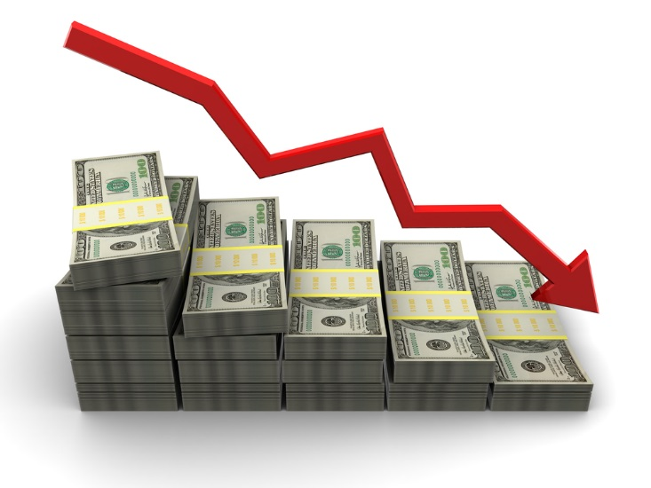
Price Decrease of 31%
Price reduction is effective MARCH 1, 2017. Annualized savings of $8,428,516 for the State of Arizona. With additional soft savings, should an agency need to engage engineering services, Sample:
Item Description | Current Rate | New Rate
HIGH NETWORK SEAT - STANDARD | $22.44 | $15.48
HIGH NETWORK SEAT - MEDIUM | $29.23 | $22.94
HIGH NETWORK SEAT - HIGH | $40.73 | $28.10
NETWORK SERVICES SEATS - STANDARD | $22.44 | $15.48
NETWORK SERVICES SEATS - MEDIUM | $29.23 | $22.94
NETWORK SERVICES SEATS - HIGH | $40.73 | $28.10
IPT OR DIGITAL PHONE DESK SEAT - STANDARD AVAILABILITY | $28.94 | $25.93
IPT OR DIGITAL PHONE DESK SEAT - MEDIUM AVAILABILITY | $30.41 | $26.94
IPT OR DIGITAL PHONE DESK SEAT - HIGH AVAILABILITY | $30.64 | $27.10
LABOR RATES | Current Rate | New Rate
ENGIINEER, ENTRY | $136.80 | $94.39
ENGIINEER, JUNIOR | $165.60 | $114.26
ENGIINEER, SENIOR | $194.40 | $134.13
AUTO ATTENDANT ONLY STANDARD | $4.99 | $3.44
ADD ON - MOBILE SEAT | $4.50 | $3.10
ADD ON _ VIRTUAL SEAT | $2.00 | $1.38
OPTIONAL SERVICE _ UNIFIED MESSAGING | $1.25 | $0.86
OPTIONAL COURTESY CALL BACK | $27.67 | $19.09
OPTIONAL PAGING SEAT | $2.46 | $1.70
VPN | $6.05 | $1.21
Consolidated Pricing Tables
All Voice, Network, and Services in one table

Slide 11
Equipment Acquisitions - New and Expanded Sites
Provider has accounted for incremental growth. With most growth or expansion covered during the initial contract phase, small growth was predicted with known patterns.
For a new location being added to the managed network or an existing location expanding more than 20 seats, current stock or State stock of equipment for new services will be used.
If stock is not available and equipment is needed, the provider will supply the following equipment at no additional charge:
New/Existing Standard Sites - 20 seats (phones) or less.
New Standard Availability Site that would require a single Cisco 29XX series router along with Cisco
LAN switches two 24-port or one 48-port; seat density would determine the switches placed.
If stock is not available or additional equipment is needed beyond what is supplied by the provider, the State Agency establishing the new site or expanding the existing site will be responsible to purchase the necessary equipment, in accordance with the price list titled “Final 30 Month Pricing”.
The provider agreed to a revolving carry of 3 months for allocated devices, with the exception of the last 3 months of the contract, which will be managed by ASET-EIC. All supplied equipment at no additional charge is statewide - not per site or per agency.

Slide 12
Equipment Acquisitions - New and Expanded Sites
For Medium or High Availability Sites, equipment needed beyond Standard Availability shall be purchased by the State Agency establishing or upgrading the site, in accordance with the price list titled “Final 30 Month Pricing”.
Existing Standard Sites adding Cisco LAN switches to a current site for growth in that location; this could be two 24-port or one 48-port switch.
If more then four 24-port switches or two 48-port switches are supplied by the provider in a month, additional equipment beyond this will be purchased by the State Agency, in accordance with the price list titled “Final 30 Month Pricing”.
The provider agreed to a revolving carry of 3 months for allocated devices, with the exception of the last 3 months of the contract, which will be managed by ASET-EIC. All supplied equipment at no additional charge is statewide - not per site or per agency.

Slide 13
Equipment Acquisitions – Existing Equipment
Existing and newly purchased equipment will be covered by the maintenance contract
The provider will repair or replace devices for in-service failure as before

Slide 14
Equipment Acquisitions – State Core Equipment
Expansion of WAN Shared hosted data center
Based on State desire to expand the WAN footprint, an increase in Core devices may be required. The State shall be able to engage the Provider to purchase this equipment as a One Time Cost. Configuration, install and management is not billable.
This equipment shall not include Agency Data Center Switching infrastructure.

Slide 15
BREAK
10 Minute Break

Slide 16
Agenda – 10am -12pm
Presentations
AZNet II Extension, Amendment 6 (if needed)
AWS Direct Connect
Relocation of Data Center
Disaster Recovery Testing
Informational Items
NCC Procedures (Changes) and Notification Template
Voice Mail Password Procedure
Carrier Updates
Capitol Mall Analog Migration
Survey Results
Program Measurements

Slide 17
CenturyLink Government Business
EXPANDING YOUR NETWORK ECOSYSTEM
WITH CLOUD CONNECTON
Sales Professionals: Chad, Chad and Robert
September 13, 2016

Slide 18
CenturyLink IQ Ecosystem
Managed Hosting &
Private Cloud
Secure Internet
50+ Centurylink Data Centers
(IO Data Center)
*Azure solution in process
State of Arizona Sites
Voice Services
250+ 3rd Party Data Centers
Notes:
In todays business environment its no longer about just connecting your own sites
CenturyLink has over 250 CTL & 3rd party datacenters on-net for Layer 1-Layer 3 services, providing you the maximum flexibility
Our Network Based Security service provides secure, easy to manage next generation internet access with a full Unified Thread Management.
We have over 20 nodes globally delivering this using using a fully virtualized architecture. The virtualized environment speeds delivery intervals and helps make the solution affordable to a broader range of customers. We also leverage the platform for other network services such as the over-the-top delivery for Prisim TV anywhere and ‘data lakes’ to collect key data metrics inside the network
We offer a full range of converged voice and data services ranging from SIP trunks to fully hosted voice services.
We have pre-built IQ Private infrastructure into over 50 CenturyLink datacenters allowing for logical provisioning of services which significantly improves delivery intervals and reduces costs.
We can deliver IQ Private services into 9 CenturyLink cloud centers globally
We have been helping customers connect 3rd party cloud providers such as AWS and VCA in key locations with traditional network circuits.
In October we are going to be releasing additional connectivity options into AWS VPC as well as introducing Azure Compute. This will be based on logical provisioning services over pre-deployed infrastructure which will significantly reduce the delivery intervals. Soon after we will enable NFV capabilities allowing secure access to additional services such as O365.
Next year we will continue to expand or locations and partners which we offer connections with.

Slide 19
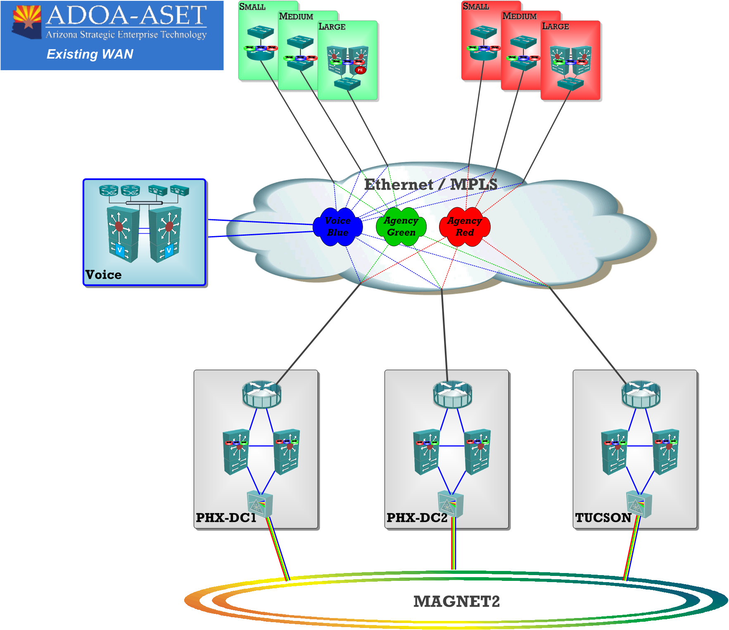

Slide 20
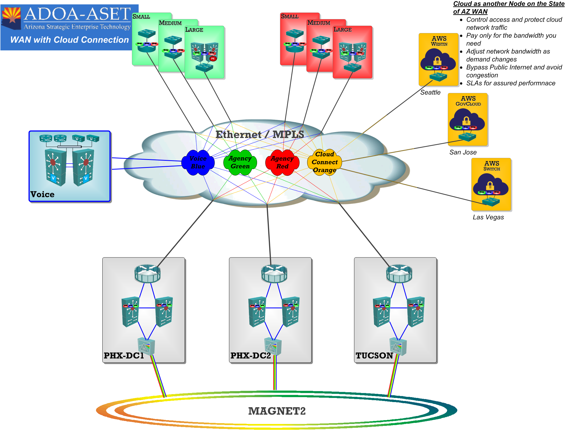

Slide 21
State of Arizona IQ+ MPLS Phoenix and Tucson Hosts Cloud Port Comparison: State Contract ADSPO15-088468
Single Agency –redundant Solution | Monthly Cost
New 400 Mbps PHX and Tucson MPLS Host | $8,118
400 Mbps MPLS at AWS (Seattle and San Jose) | $3,968
Total Cloud Connect Solution | $12,086
Cross connect fees will apply at each data center
Existing Phoenix and Tucson 600 MPLS Hosts | Monthly Cost
Phoenix 600 Mbps | $5,010
Tucson 600 Mbps | $5,010
Total Monthly Today | $10,020
Difference to upgrade existing service: $7,578 Monthly
Cloud Connect Redundant Solution | Monthly Cost
Upgraded 1 Gbps Phoenix and Tucson Hosts | $13,630
400 Mbps MPLS at Seattle AWS | $1,984
400 Mbps MPLS at San Jose AWS | $1,984
Total Cloud Connect Solution | $17,598

Slide 22
State of Arizona IQ+ MPLS Tiered Cloud Port: State Contract ADSPO15-088468
The tables below show a tiered increase in bandwidth and monthly cost for the redundant solution connecting 2 State locations to 2 AWS data centers, fully meshed.
Increase to 1 Gbps Cloud Connect Solution | Monthly Cost
Phoenix and Tucson Hosts with Seattle and San Jose | $7,578
Cross connect fees will apply at each data center
Increase to 2 Gbps Cloud Connect Solution | Monthly Cost
Phoenix and Tucson Hosts with Seattle and San Jose | $23,440
*bandwidth includes existing 600 Mbps being used for the State WAN
Increase to 3 Gbps Cloud Connect Solution | Monthly Cost
Phoenix and Tucson Hosts with Seattle and San Jose | $36,836

Slide 23
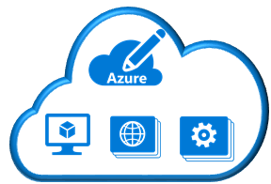
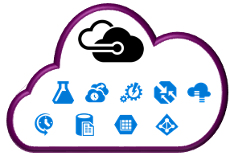
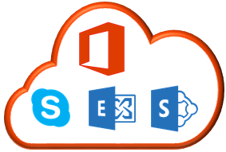
Multi-Cloud Access
*Azure solution in process
AZURE Express Route
Location
Microsoft Datacenters
Azure
Compute
Azure Public
Services
IQ+ Cloud
Port
Transit
VLANS
Microsoft
Edge
Office 365
AWS Direct Connect
Location
AWS Region
IQ+ Cloud
Port
IQ+ Cloud
Port
Transit
VLANS
Direct
Connect
Router

Slide 24
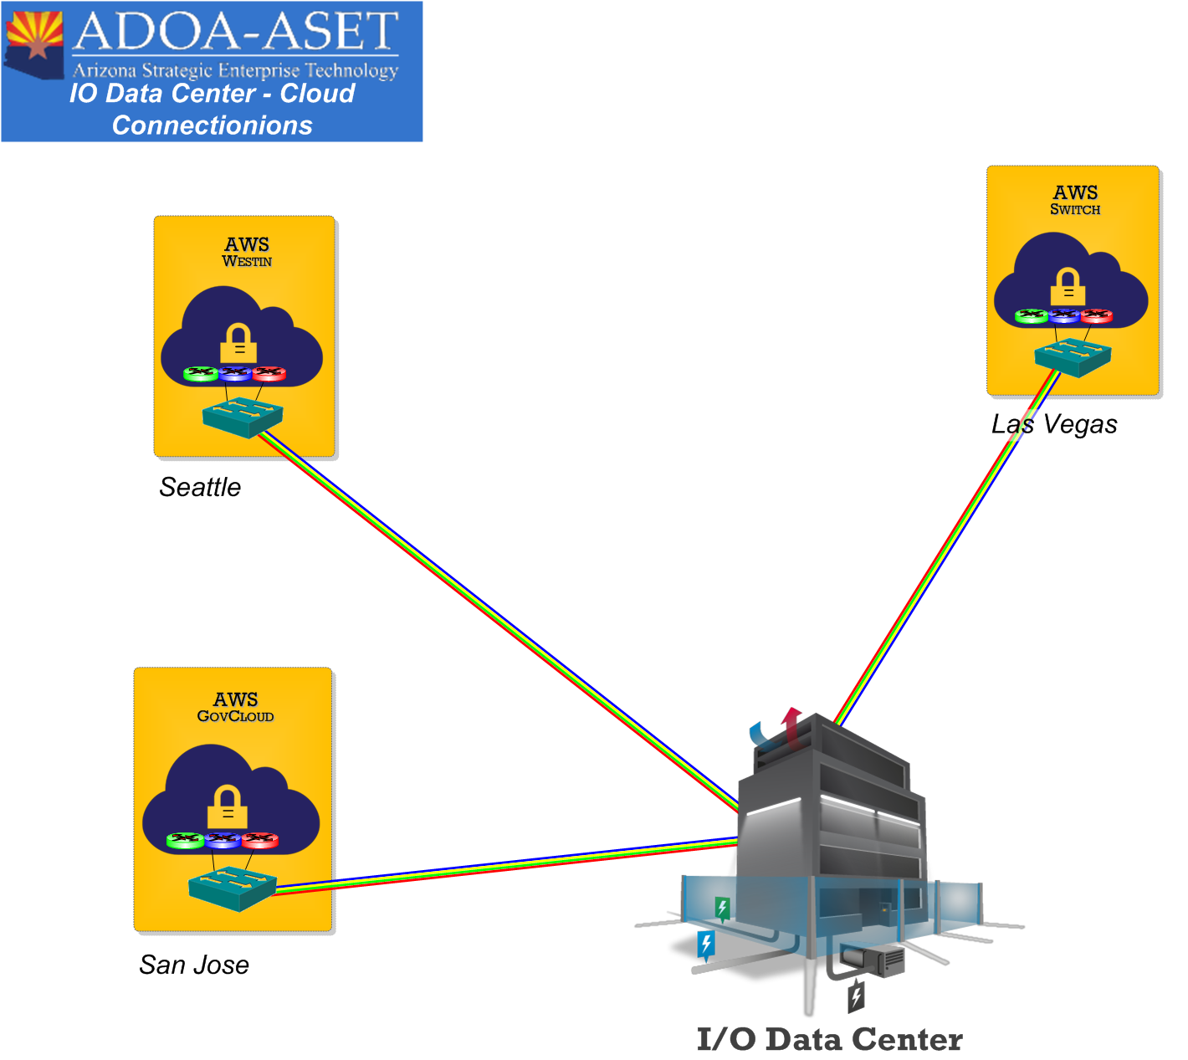
Optical Wave Service (Point-to Point) Cloud Connections at IO Data to AWS Data Centers:

Slide 25
State of Arizona OWS Point-to Point Cloud Connections at IO Data: State Contract ADSPO15-080717
Locations | 1 Gbps OWS Point-to-Point | 10 Gbps OWS Point-to-Point
AWS San Jose | $1,500 | $3,000
AWS Seattle | $1,500 | $3,000
AWS Las Vegas | $1,500 | $3,000
Cross connect fees will apply at each data center

Slide 26
CenturyLink and AWS Locations
Provider | Location | Address
AWS Direct Connect Locations | Ashburn, VA (AWS = Equinix DC1-DC6) | 21701 FILIGREE CT, ASHBURN, VA 20147, Suite 100
AWS Direct Connect Locations | Dallas, TX (AWS = Equinix DA2) | 1950 North Stemmons Freeway, Suite 3050, Dallas, TX 75207
AWS Direct Connect Locations | New York, NY (AWS = Coresite 32 Ave of the Americas) | 32 Avenue of the Americas, NY, NY
AWS Direct Connect Locations (GovCloud) | San Jose, CA (AWS = Equinix SV1 & SV5) | 11 Great Oaks Blvd, San Jose CA 95119 Suite 100
AWS Direct Connect Locations | Los Angeles, CA (AWS = Coresite One Wilshire) | 900 N Alemeda St. Los Angeles, CA 90012 Suite 213
AWS Direct Connect Locations | Seattle, WA (AWS = Equinix SE2 & SE3) | 2001 Sixth Ave, The Westin Bldg Suite 1202, Seattle, WA 98121 **Available in October 2016
AWS Direct Connect Locations | Las Vegas, NV (AWS = Switch SUPERNAP 8) | 7135 S. Decatur Blvd., LAS VEGAS, NV 89118 **Will need to use a bundle router solution for MPLS at this location. Pricing is ICB at this location
CenturyLink is not currently in EdgeConneX Portland, OR.

Slide 27
CenturyLink and Microsoft AZURE Express Route Locations
Provider | Location | Address
AZURE Express Route Locations | Chicago | 350 E CERMAK RD, 7th Floor Transport, CHICAGO, IL, 60616
AZURE Express Route Locations | Silicon Valley | 11 Great Oaks Blvd, San Jose CA 95119 Suite 100
AZURE Express Route Locations | Washington DC | 21701 FILIGREE CT, ASHBURN, VA 20147, Suite 100
AZURE Express Route Locations | Dallas | 1950 North Stemmons Freeway, Suite 3050, Dallas, TX 75207
AZURE Express Route Locations | New York | 755 Secaucus Rd, Secaucus, NJ 07094
AZURE Express Route Locations | Seattle | 2001 Sixth Ave, The Westin Bldg Suite 1202, Seattle, WA 98121
AZURE Express Route Locations | LA, Atlanta, Virginia and Iowa
Azure solution in process with CTL product management and Microsoft

Slide 28
Questions?
Thank You

Slide 29
Shared Hosted Data Center Phase I Establish Presence
Suzan Tasvibi-Tanha
Chief of Managed Services

Slide 30
Business Problem
State Data Center (SDC) Aging Facility not Sustainable.
There are more than 140 State entities that leverage the SDC’s infrastructure, services, and capabilities for mission-critical services.
The current facility is considered one of two major points of entrance and exit of IT services into the State owned fiber/copper networks.
Abandonment of State owned Fiber will result in extensive carrier cost for service delivery to each facility.
Over 35 facilities and 11,000 users are on the Capitol Mall, including the Governor’s Tower.

Slide 31
CAPITOL MALL INFRASTRUCTURE

Slide 32
Requirement
Shared Hosted Data Center(HDC) must:
Be minimum a Tier 3 as defined by Telecommunications Industry Association(TIA)-942: Data Center Standards.
Large enough for expansion of State agencies footprint
Have both white (raised floor) space and Modular space
Meet all state & federal security requirements
Technology solution must:
Provide redundancy by design
Allow leveraging and extending of State owned Fiber
Allow multi agency service hand off via equipment specifications

Slide 33
Recommended Solution
Lease space at I/O Data Center
Lease 4 strands of Commercial Fiber
Fiber Splicing at the Capitol Mall
Acquire and Deploy Dense Wavelength Division Multiplexing (DWDM) to connect Capitol Mall to I/O via leased Fiber
Acquire and Deploy Data Center switching Infrastructure

Slide 34
Benefits
Service Enhancement
Leverage a Tier III Datacenter physical security and environment
Problem Avoidance
Reduce major IT system outage due to environmental issues, i.e. electrical or building cooling systems
Risk Avoidance
Moving a critical system out of an aging building
Cost Avoidance/Reduction
No additional carrier charge by leveraging the DWDM
Disconnect agencies dedicated carrier connection from the Capitol Mall to I/O and leverage DWDM

Slide 35
TimeLine
An alternate main distribution frame (MDF) has been identified to replace the State Data Center as a new HUB for State Fiber (main distribution Frame(MDF)).
Installation of conduit and Fiber Splicing for 1116 strand of Fiber into the new MDF need to be completed
Identify, validate required space and execute the task order through State Data Center contract at I/O Data Center (referred to as Shared Hosted Data Center (HDC)).
Secure 2@ 2 pair of Dark Fiber from commercial carriers to extend state Fiber to a remote Data Center.
Acquire managed Dense Wavelength Division Multiplexing (DWDM) equipment to channelize the lease fiber to match current capacity of the state owned Fiber
Purchase, Configure and install Data Center switching.
Purchase, install 1st row of Data Center Rack with required connection to start the migration of servers

Slide 36
Budget
Description |  | Type | Year 1 | Year 2 | Year 3 | Year 4 | Year 5 | Extended Cost
Professional & Outside Services |  | Development | $28,156 | $0 | $0 | $0 | $0 | $28,156
 |  | Operational | $0 | $0 | $0 | $0 | $0 | $0
Hardware |  | Development | $1,656,008 | $0 | $0 | $0 | $0 | $1,656,008
 |  | Operational | $0 | $591,251 | $0 | $0 | $0 | $591,251
Software |  | Development | $0 | $0 | $0 | $0 | $0 | $0
 |  | Operational | $0 | $0 | $0 | $0 | $0 | $0
Communications |  | Development | $41,051 | $0 | $0 | $0 | $0 | $41,051
 |  | Operational | $0 | $41,051 | $0 | $0 | $0 | $41,051
Facilities |  | Development | $245,583 | $0 | $0 | $0 | $0 | $245,583
 |  | Operational | $740,850 | $1,481,699 | $1,481,699 | $1,481,699 | $1,481,699 | $6,667,647
Licensing & Maintenance Fees |  | Development | $118,956 | $0 | $0 | $0 | $0 | $118,956
 |  | Operational | $0 | $0 | $0 | $0 | $0 | $0
Other |  | Development | $215,028 | $0 | $0 | $0 | $0 | $215,028
 |  | Operational | $0 | $0 | $0 | $0 | $0 | $0
 |  | Development Cost: | $2,304,781 | $0 | $0 | $0 | $0 | $2,304,781
 |  | Operational Cost: | $740,850 | $2,114,001 | $1,481,699 | $1,481,699 | $1,481,699 | $7,299,948
 |  | Total Cost: |  |  |  |  |  | $9,604,729

Slide 37
ROI on DWDM
The following table illustrates the ROI for implementing the proposed DWDM network infrastructure vs. implementing point-to-point network connections.
Implementation | Carrier Wavelength | Carrier Wavelength | Carrier Wavelength | Implementation | Cumulative ROI
with out DWDM Equipment | QTY Implemented | Total | Cost Annually | with DWDM Equipment
Year 1 | 23 | 23 | $828,000 | $2,956,255 | ($2,128,255)
Year 2 | 24 | 47 | $1,692,000 | $2,128,255 | ($436,255)
Year 3 | 24 | 71 | $2,556,000 | $436,255 | $2,119,745
Year 4 | 9 | 80 | $2,880,000 |  | $4,999,745
Year 5 | 0 | 80 | $2,880,000 | $0 | $7,879,745
Total 5 Years |  |  | $10,836,000
Annual Cost Avoidance on 80 Gig of connection after YR 4= $2,880,000

Slide 38
QUESTIONS

Slide 39
DR Testing Schedules
DATA
Data Core Data Center PE Failover
October 02, 2016 October 30, 2016
8:00am to 4:00pm 8:00am to 2:00pm
Core Network
Circuit Redundancy
Fiber Failover
All documents can be found at: https://mycenturylinkonline.net/AZNetII/Disaster%20Recovery/Forms/AllItems.aspx
SharePoint → Disaster Recovery → DR 2016
October 16, 2016
8:00am to 2:00pm
SECURITY
Internet Carrier
VPN
Firewall/IPS
Enterprise Core UCCE Core
October 15, 2016 October 22, 2016
8:00am to 5:00pm 8:00am to 5:00pm
VOICE
Voice Core Equipment
Call Center Failover

Slide 40
NCC Procedure Changes
Low Risk/Standard Changes
Low Risk/Standard Changes have been identified and Pre-Approved with blanket NCC – Voice, Network, Security
Conducted during Normal Maintenance Window (Tuesday/Thursday)
Medium and High Risk
Not impacted by change

Slide 41
NOC Notification Template Changes
Updated Template is designed for a cleaner view via email and smart phones
It will bring attention to the current status, activity and next update time
The same pertinent information will be included on the notification as well as some new data elements:
Reported By
Technical Owner
Engaged Resources
Customer Bridge information will be included in the Key Groups Engaged section when applicable

Slide 42
Voice Mail Password Procedure Changes
Summary must contain Primary Contact name, email, and phone number.
It is recommended to include a Secondary Contact in the Summary
Notification by Email to User if Primary and Secondary Contact not reached by phone
User required to change password upon accessing

Slide 43
Carrier Updates
2nd CTL Host at 206 S 17th Data Center
New Integra (Electric LightWave) Host – PHX and TUC
AT&T Host PHX and TUC – In Progress
AWS Connection pending Oversight Approval
All part of Shared Infra

Slide 44
Analog Gateways on Capitol Mall/Tucson
Deployment is required to move the analog services, i.e. elevator, emergency phones, fire and security lines off of SL100
Approximately 1200+ analog lines to be moved off of SL100
All Installation Locations have been completed:
800 W Washington- Industrial Commission building
1801 W. Jefferson- ADOT/ Motor Vehicle Building
150 S 18th Ave- Health Services Building
1510 W. Adams- ADOA Data Center
1700 W. Washington- Governor’s Tower
206 S. 17th Ave- ADOT Data Center
400 W Congress

Slide 45
2016 Annual AZNet II Survey
Overall Responses
Scores by Category
Agency Response Rates
Score by Agency Size
Respondent Type

Slide 46
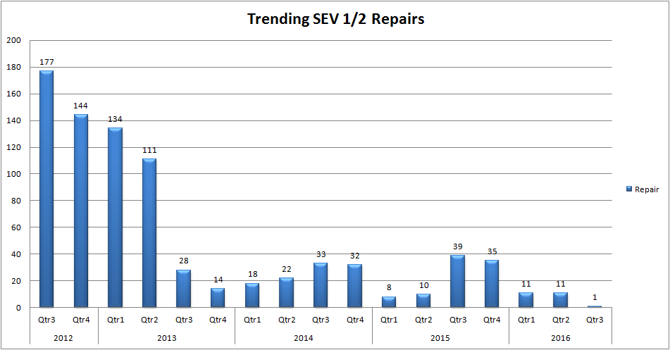
Trending Ticket Data (Since Contract Inception)
(Updated Monthly)

Slide 47
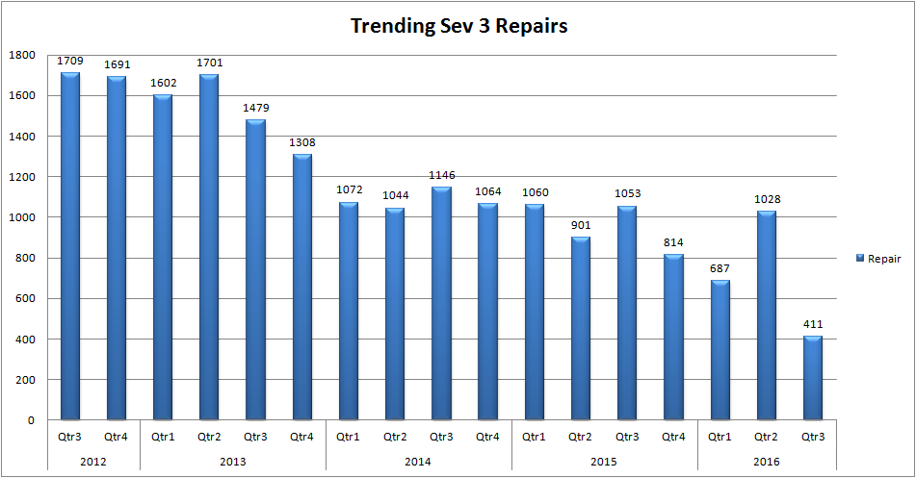
Trending Ticket Data (Since Contract Inception)
(Updated Monthly)

Slide 48
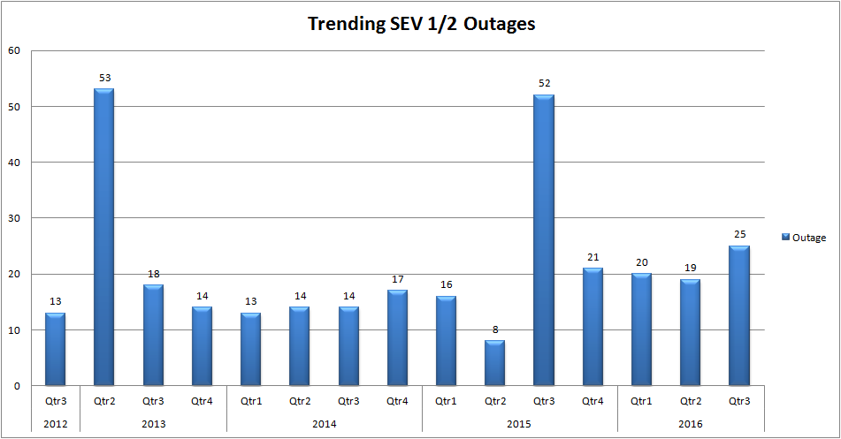
Trending Ticket Data (Since Contract Inception)
(Updated Monthly)

Slide 49
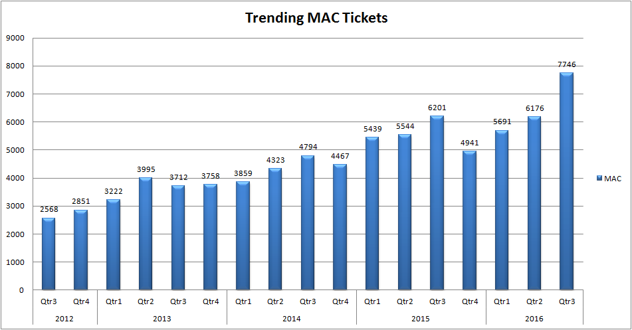
Trending Ticket Data (Since Contract Inception)
(Updated Monthly)

Slide 50
Roundtable
Next meeting
Thursday, January 26, 2017 – 9:00 A.M.
Sawtooth Conference Room

