Slide 1


Introducing CenturyLink
Notes:
Thanks for giving me a few minutes to speak about our company.

Slide 2

Our History
“If you do the right things, success will follow.”
– Clarke M. Williams, Founder
During more than 60 years of service, Clarke M. Williams laid a foundation of leadership and integrity that will forever shape our view of how to manage the Company.
Mr. Williams set a lasting example for our company, both in the way he conducted business and in the way he led his life. His legacy is most clearly manifested in our Unifying Principles. These attributes are the foundation upon which our company is built.
2
Notes:
We trace our roots to the 1930s as a small telephone company in Oak Ridge, Louisiana, that served fewer than 100 customers. Clarke Williams, our founder, ran the company as he lived his life … with concern for others, a positive attitude and integrity above all else. His legacy remains in place today and defines of our view of how to manage the company, serve our customers, and work together.

Slide 3
Our Unifying Principles
Fairness
Honesty & Integrity
Commitment to Excellence
Positive Attitude
Respect
Faith
Perseverance
Notes:
CenturyLink was built upon a set of Unifying principles and we still use those principles to guide us. These principles guide our basis for conducting business and they are the foundation of our relationship with each other, our customers, shareholders, business associates and the general public. We really operate within these principles – it’s part of our “walking the walk” with ourselves and our employees.
We are committed to these principles which unify CenturyTel's beliefs into a cohesive philosophy that guides our actions in all matters.
Fairness – The Golden Rule
Honesty and Integrity
Commitment to Excellence
Positive Attitude
Respect
Faith
Perseverance

Slide 4
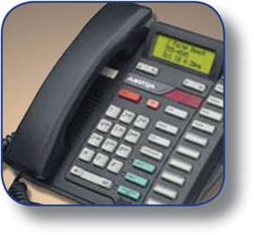



CenturyLink is an industry leader
Pro forma 2011 annual revenues of $18.5 to $18.8 billion*
Serve customers ranging from Fortune 500 companies to families in rural America
Customers as of September 30, 2011
  14.8 million access lines
  5.5 million broadband customers
  1.8 million video customers
210,000 route mile national fiber network
Committed to being the broadband leader in our markets
Global leader in managed hosting and cloud services
*Pro forma guidance for FY2011 as of November 2, 2011, which is valid only as of that date. Includes purchase accounting adjustments.
Notes:
Customize content here as needed.

Slide 5
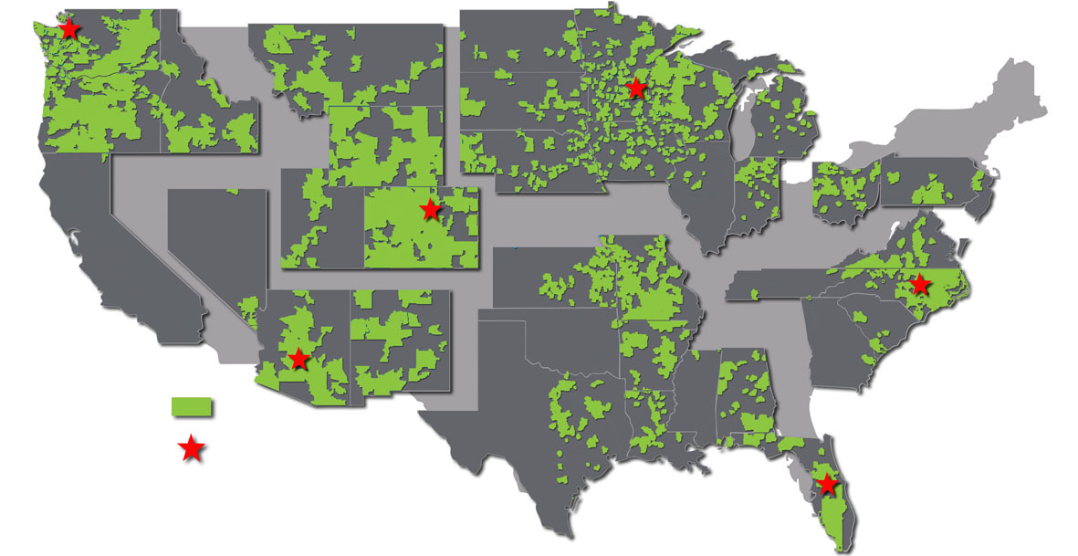
CenturyLink is a local company
Northwest Region
HQ: Seattle, Wash.
President: Brian Stading
Mountain Region
HQ: Denver, Colo.
President: Kenny Wyatt
Midwest Region
HQ: Minneapolis, Minn.
President: Duane Ring
Eastern Region
HQ: Wake Forest, N.C.
President: Todd Schafer
CenturyLink Local Territories
Region HQs
Southwest Region
HQ: Phoenix, Ariz.
President: Terry Beeler
Southern Region
HQ: Apopka, Fla.
President: Dana Chase
Notes:
5
This map reflects our six regions or market clusters across the U.S.
The Eastern Region includes the states of GA, NJ, NC, OH, PA, SC, TN and VA.
The Midwest Region includes the states of IL., IN, IA, MI, MN, NE, ND, SD and WI.
The Mountain Region includes the states of CO, MT, UT and WY.
The Northwest Region includes the states of CA, ID, OR and WA.
The Southern Region includes the states of AL, AR, FL, KS, LA, MS, MO, OK and TX.
The Southwest Region includes the states of AZ, NV, and NM.
These regions further include a total of 36 markets or service area clusters that are led by VP/General Managers and their local team of employees that bring sales and service decision-making closer to the customer.
Advantages of Local Operating Model
Strong Market Based Ownership & Accountability
Decision Making Close to the Customer
General Manager Structure Supported by Region Leadership
Segment Focused Marketing
Segment Approach, Increased Wallet Share, New Products & Services
Service Delivery Support Structure
Customer Retention, New Customer Acquisition & Win-back
In and Out of Market Enterprise Growth Enabled by Core Network
Efficient Cost Structure – “Lean & Mean”
Simplicity - Easy for the Customer & the Employee

Slide 6
Local Depth Arizona
Local Presence:
Employees: 3,140 in Arizona
Annual Payroll: $232M, $7M Annual Payroll Tax
City of Phoenix Revenue: $6.9M
State of Arizona Revenue: $35M
AZ Network Investment: $7.3B
Local Contributions: $685K
Local Leadership:
Region President: Terry Beeler
Vice President/General Manager: Ken McMahon
Vice President/General Manager: Guy Gunther
VP Regulatory and Legislative Affairs: Jerry Fenn
VP SOHO/Mid-Market Sales: Betty Reynolds
Director Sales Government and Education: Al Macaluso
Director Sales Business Markets Group: Matt Fassnacht
Decisions about Phoenix are made in Phoenix!

Slide 7
AZNetII Technology Evolution
July 16, 2012

Slide 8
CenturyLink Vision
Transition existing data and voice service and support to the Centurylink Operations team.
Stabilize existing service through chronics reviews and action plans
Design a redundant state of the art core and data center infrastructure adding increase business value to the State of Arizona Stakeholders
Implement Technology with the features and services that meet the Design and Engineering Principles of AZNetII
Meet and exceed the contract service level requirements (SLR’s)
Provide Excellent Customer Service
Maintain High Service and Network Reliability
Provide “increased value” to the State of Arizona Stakeholders
Perform technology refresh projects within contract timelines

Slide 9
Increase Value to the State of Arizona Stakeholders
Lower the Total Cost
of Ownership
Reduce operating expenses
Improve network efficiency
Build a flexible and adaptable network topology
Develop recommendations for technology strategies
Migration and implementation to approved technology to improve standardization
Increase
Network Reliability
Assess the current network capability to accommodate the proposed system
Produce an optimal network design to prevent network congestion, delay and errors.
Validate the network performance for the expected network performance and operation
Proactively monitor and address availability, security
Optimize the network to enhance performance
Improve Agility
Establish business requirements and standards
Provide for future interconnectivity
Develop a migration path to future network technologies without redesign
Use technology that complies with industry standards and is a leader in that technology
Enable Services, Features and Applications
Improve operational readiness
Improve service-delivery efficiency and effectiveness through standardization
Improve availability, reliability, and stability of the network and applications

Slide 10
AZNetII Engineering Principles Methodology
Assess Needs
Operational challenges
Installation issues
Gather Requirements
Define the issue
Gather the supporting documentation
Compare
Industry standards
Manufacturer Best Practices
IETF Recommendations
AZNetII Engineering Goals & Objectives
Review current process
Define and Recommend
AZNetII Review
IEIC/ADOA Review
Establish and Provide to
AZNetII Engineering and Operations
ADOA and EIC
Publish to SharePoint and AZNetII website
Design Approach
Understand the Agency business and system requirements
Document the requirements and assessment for review
Comply with the AZNetII general overarching, high level Network Engineering Design Principles
Use Best Practices for the Implementation and Transition to Service (ITIL)
Define and develop recommendation for review and consideration
Communicate to stakeholders

Slide 11
New Site Data Architecture
New Site – Data Architecture:
Routers
To maintain a consistent, efficient and cost-effective environment, a single vendor deployment statewide using Cisco Systems routers is recommended. A limited set of Cisco routers will be defined and used for agency deployments. Consideration will be given to other manufacturers if a requirement exists.
Routing Protocols
Routing protocols used in the network will be OSPF, EIGRP, iBGP and BGP. Static routing will only be used in limited and necessary circumstances. By design, routing goals should provide the shortest/smallest routing tables possible. Route summarization and default routes should be employed where appropriate throughout the entire state network.
WAN Bandwidth Requirements
Site Bandwidth requirements will be evaluated on a site by site basis. Site seat count and usage requirements (i.e. call center, video, hub site, etc.) will determine the specific circuit size.
WAN and MAN Connectivity Options
WAN connectivity will be based on dark or dim fiber solutions, or, when available, Metro Optical Ethernet. If the designated carrier’s Metro Optical Ethernet is not available or cost effective, it may be possible to obtain Metro Optical Ethernet from an alternative carrier. If possible, Hub sites must be connected through Metro Optical Ethernet. When dark or dim fiber is available, Gigabit Ethernet connectivity onto MAGNET-2 will be provisioned with private Metro Optical Ethernet. For sites requiring additional resiliency, Optical solutions will be considered when other sites with similar requirements can be connected via a SONET ring. Enabling the security and privacy features of Metro Optical Ethernet is the preferred design option, whether a carrier-provisioned service, AZNetII-provisioned service or a hybrid of both.

Slide 12
New Site Voice Architecture
New Site – Voice Architecture:
Routers
The routers identified in the new site Data Architecture section support IPT.
QoS
QoS will be provisioned on all WAN links when voice or video traffic is traversing the links. CoS will be provisioned on LAN infrastructure in line with Cisco best practice recommendations for IPT deployments.
IPT Migration
New sites will migrate to IPT if practical. IPT migration will be implemented in the following order, if possible:
  All sites using the SL-100 will migrate to the Cisco IPT Cluster.
  All Phoenix on the Mall and Tucson sites will migrate to the Cisco IPT Cluster.
  All small sites (>10 seats) will migrate to the Cisco IPT Cluster (if possible).
Sites that do not fit in the three definitions above shall have their voice equipment determined on a site by site basis. The alternative choices are only Cisco IPT using the Cluster or a Local Call Processing design or a VoIP-enabled Nortel BCM or SC1000.
IPT Cluster Architecture
The IPT Cluster is based upon a multi-site centralized call processing model with three (3) physical locations:
Two sites for the northern half of the state
One site for the southern half of the state
The two sites in the northern half of the State are Phoenix nodes on the MAGNET-2 optical ring. The site in the southern half of the State is a Tucson node on the MAGNET-2 optical ring. Inter-cluster trunks will be used to connect any standalone IPT clusters (e.g. ADC Prison Locations) to the centralized IPT Cluster, to ensure interoperability and functionality. This architecture will support inter-site dialing, toll by-pass, and tail end hop off functionality.

Slide 13
New Site Voice Architecture cont..
New Site – Voice Architecture:
Compression
G.711 call compression will be used for calls on MAGNET-2 due to the high availability of bandwidth. G.729a will be used when communicating to remote locations over lower bandwidth WAN links.
Centralized Call Processing and Voice Mail
All sites that are not directly on the Phoenix Capitol and Tucson Malls will use centralized IPT call processing unless business requirements require a stand alone cluster. The decision to use either centralized or local call processing will be made on a case-by-case basis at locations with more than 360 users. Cost of bandwidth and redundant WAN services will determine whether local call processing is necessary. Voice mail will be provided statewide via a centralized model using the Unity solution within the IPT Cluster.
UPS Run-Time Requirements
Additional run-time capacity may be required in addition to the run-time configured to support the site’s data requirements. These extra battery packs should increase the run-time requirements to support the additional up-time requirements for IPT.
Redundant Call Processing
The recommended routers will support call processing redundancy for IPT. Survivable Remote Site Telephony (SRST) licensing is based on the number of handsets per site.
IP Addressing
The appropriate voice IP address ranges will be allocated from 172.16.x.x – 172.31.x.x and Dynamic Host Configuration Protocol (DHCP) support will be configured on the Cisco routers for each agency voice VLAN. The 172.16.x.x – 172.31.x.x. ranges, assigned by the State’s IP Addressing Committee in August 2006, will be appropriately configured for the voice requirements of each agency.

Slide 14
Existing Sites
Existing Site - Data Architecture (Upgrade of an Existing Site):
When upgrading a site’s data architecture, the preference is to replace the existing equipment with the recommended new equipment unless the existing equipment is current, if existing equipment is used the equipment will be refreshed one time by the end of the contract term. Keeping legacy equipment is not typically in line with architectural principles and device currency. Unless a critical business justification exists, the recommendation is to pursue the standardized approach aligning with architectural principles. In addition, consolidating sites (cross-agency) is highly recommended when cost effective and the design can still support each agency’s requirements.
Circuit capacity and protocol (e.g. Metro Optical Ethernet) will be determined on a case-by-case basis in accordance with the overall network engineering design principles.
All other requirements specified for a new site are the same for upgrading an existing site.
Router Remote Access
  Modem – Cisco routers will include an analog WIC modem for optional remote access
  1FB (single line, flat business rate) – each site that contains a router that AZNet manages will have an optional single 1FB connection dedicated for the WIC modem. The agency can also elect to use an analog port off an existing Key System or PBX at that location.
Existing Site – Voice Architecture (Upgrade of an Existing Site):
When multiple sites merge or consolidate, the agency that is moving sites will migrate onto the existing infrastructure. If necessary, the existing infrastructure will be expanded to accommodate the new agency.
Unless a critical business justification exists, voice architecture upgrades will implement IPT. However, if the existing voice system is one of the approved new voice systems and is N-2 or can be upgraded to an approved system in a cost effective fashion, then that system can be expanded to support the new tenant.

Slide 15
Technology Refresh Strategies
Stabilize Service
Identify chronic systems or service problems
Develop Service Recovery Plans for each problem agency site
Analyze/Evaluate challenges and issues for technology refresh
Identify Risk and Technology Obsolescence
Document End of Life (EOL) or End of Support systems
Develop Prioritization lists based on criteria
Develop project plans
Prioritize the Findings (SoA Voice Risk)
Critical-High Risk-Medium Risk-Low Risk
Project Priorities
Design and Build Solution
Build the Data Center Core Network Infrastructure
Design and Build the Core Data Center Platform
Design and Build the Core Infrastructure
Design and Build the Network Connectivity and Topology
Implementation
Operational Analysis and Network Assessment
Migration Strategy and Planning
Architecture Design Review, Validation and Development
Implementation Plan, Service Test Plan, Acceptance Plan and Implementation
Operation and Optimization

Slide 16

Build a Redundant Data Center Topology

Slide 17
Architectural Requirements
Assess the current environment
  Current Network Topology
  Discovery data from current switches and routers
Identify areas of vulnerability and Risk
  Single point of failure
  Redundancy and Data Center locations
  Environmental concerns
Identify the business needs
  Features and solutions
  Capacity considerations
Design the solution
  Architect the solution using IETF and best practices
  Follow the Plan Design Implement Operate Model

Slide 18
Build the Core Infrastructure
Implement the core network infrastructure to support services agency migration
IP VPN Metro Optical Ethernet

Slide 19
IP SIP Connections to the agencies

Slide 20
AS for Service Provider
PDIOO Framework
Implementation and Transition to Service
Performance Monitoring
Acceptance Test Plan
Development
Performance Engineering
& Optimization
Operational Readiness
Assessment
Architecture
Design
Acceptance Test Plan
Review
Software Strategy
Network Reliability
Improvement Analysis
Design Validation
Implementation Plan
Review
Lifecycle Management
Network Architecture
Strategy/Review
Detailed Design
Review
Implementation Plan
Development
Operations
Management
Migration Strategy
Detailed Design
Development
Implementation
Key Performance Measures
Deployment Engineering and Project Management Support Teams
Operations Teams Performance Management and Service Management
Plan
Design
Implement
Optimize

Slide 21
Technology Refresh Timeline
Network
Network Discovery July 9-27
Review and Analysis of the network discovery findings August 6-21
Identify network users (voice/data migration) August 6-24
Design the required network capacity August 28-September 14
Collect input from the State’s representative’s/stakeholders for prioritization August 27-31
Place network orders for core network infrastructure September 7
Voice
Assume responsibility for current voice systems. July 31
Assess the potential concerns and shortfalls for the existing voice systems July 23-August 17
Use the discovery information to evaluate the functionality, usability, reliability, and potential problems the systems might have. On-going
Identify the system as Critical-High-Medium or Low Risk-Complete
Develop the platform/system solution September 7-28
Develop the migration plan and resources September 7-28
Implementation of the core phone system October 1-November 20
CenturyLink will have the core phone system installed within 90 days of the network portion being completed.

Slide 22
Technology Refresh Timeline
Network
Upon contract award, CenturyLink will meet with representatives and stakeholders from the State and Agencies and the current vendor to jointly define the transition timeline and milestones. CenturyLink will propose a baseline Transition Plan based on our proven processes and experience with customers of similar scope and size. CenturyLink will then collect input from the State’s representatives and stakeholders to identify and prioritize transition activities that will least impact the State’s critical business requirements and mission critical applications. If current processes and operational standards align with CenturyLink’s current methodologies, they may be adopted and directly transitioned
Voice
Upon contract award, CenturyLink will assume responsibility for all voice systems. CenturyLink will use the discovery phase of the contract to work with the State to determine the potential concerns and shortfalls the State has for the existing voice systems and assess the current systems to evaluate the condition and continued usability for each system. The discovery phase allows CenturyLink to evaluate the major components of the State’s voice systems in place today and with the State prioritize the refresh of the equipment during the life of the contract. This allows us to determine functionality, usability, reliability, and potential problems the systems might have. Our findings during the discovery phase will not impact the seat price or what is considered in scope. CenturyLink has built in a complete voice refresh in the response. This includes refreshing all handsets and phone systems that are in place today. CenturyLink will have the core phone system installed within 90 days of the network portion being completed.

